Slide 1

UMASSGRAM
social media platform for Umass Students
Nitish Bhattad – 02161236 - 03
Shushma Dewie kopprieddy – 02190612- 18
Harshith Nerlikere Ramesh – 02163725 - 28

Slide 2
Project Overview
Problem Statement:
With the rise of social media among university students, there is a lack of platforms tailored specifically to academic environments. Generic platforms like Instagram or Facebook are often overwhelming and lack features specific to a student’s academic or social context.
UmassGram solves this by creating a secure, closed-community platform for UMass students, enabling them to post, like, comment, follow, and share feedback in a university-only environment.

Slide 3



Technologies
Flask (Python Web Framework)
MySQL (Relational Database)
HTML, CSS
Local file uploads for posts

Slide 4

Key Features
Secure login/register system
Upload posts with images and captions
Like, comment, save, and delete posts
Follow/unfollow users and user profiles
Anonymous feedback and notification system

Slide 5
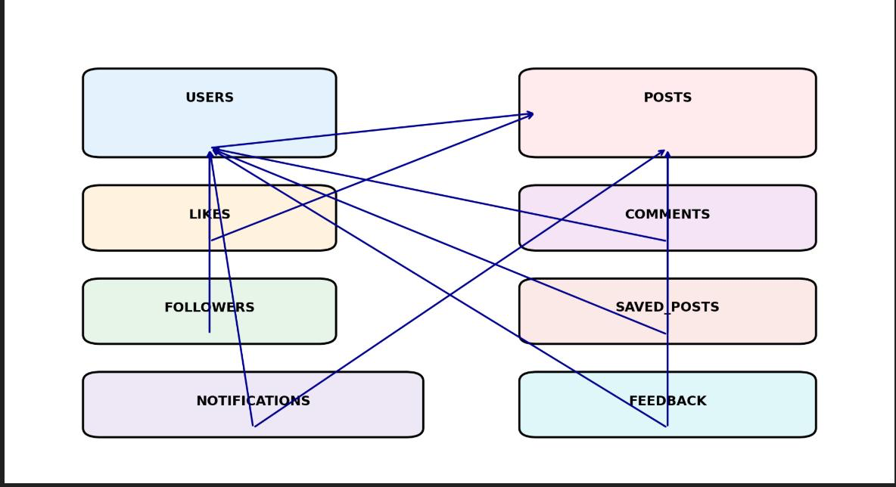
ER Diagram

Slide 6
Conclusion
👨‍💻 Conclusion:
UmassGram successfully blends core social media elements with a restricted, academic user base to foster a sense of community among UMass students. It’s an ideal full-stack portfolio project that demonstrates backend logic, SQL relationships, Flask security, and frontend polish. Additionally, it reinforces best practices in user authentication, role-based access, and modular development. With a rich set of features tailored for an academic community, UmassGram is a scalable and creative demonstration of end-to-end web application development..

